Slide 1
www.rightwayglobal.in

Slide 2
PRODUCTS & BUSINESS PLAN

Slide 3
PRODUCTS

Slide 4
SUPER NATURAL PRODUCTS
PRODUCTS | QUANTITY | MRP | REF | BV | DP | BV
RIGHTWAY’S MUPPU DROPS RIGHTWAY’S NEURO DROPS | 50ML 50ML | 3000 2800 | 300 300 | 270 250 | 2700 2500 | 250 230
RIGHTWAY’S SIDDHA MUPPU SPRAY | 30ML | 3000 | 300 | 270 | 2700 | 250
HONEY GLOW | 220GM | 24000 | 1000 | 2300 | 21500 | 2100
HONEY GLOW MINI | 120GM | 13600 | 600 | 1300 | 12200 | 1200
RIGHTWAY’S ORGO PLUS | 50G | 3000 | 300 | 270 | 2700 | 250
RIGHTWAY’S GLUCO SAFE | 100G | 3000 | 300 | 270 | 2700 | 250
RIGHTWAY,S BETA SHIELD | 50ML | 3000 | 300 | 270 | 2700 | 250

Slide 5
AGRI - PRODUCTS
PRODUCTS | QUANTITY | MRP | BV | DP | BV
ROYAL BUMPER | 1KG | 1800 | 120 | 1530 | 90
SUPREME COMMANDER | 100ML | 700 | 46 | 550 | 32
ROYAL BORON | 500GM | 750 | 49 | 640 | 38
SUPREME LEAF | 25GM | 220 | 14 | 190 | 11
DR.HERBAL | 250ML | 550 | 36 | 470 | 30
AGRI BOOST | 250ML | 350 | 23 | 300 | 18
TRIPPLE GAIN | 500GM | 550 | 28 | 470 | 18
KILLER INSECTS | 100ML | 900 | 59 | 700 | 35
ROYAL GEL | 1KG | 800 | 45 | 680 | 31

Slide 6
NAPKIN - PRODUCTS
PRODUCTS | QUANTITY | MRP | BV | DP | BV
NANNY NAPKINS | 240MM | 200 | 5 | 180 | 4
NANNY NAPKINS | 290MM | 200 | 5 | 180 | 4
NANNY NAPKINS | 330MM | 200 | 5 | 180 | 4
NANNY PANTYLINERS | 155MM | 300 | 6 | 260 | 5

Slide 7
OFFER PACKAGES

Slide 8
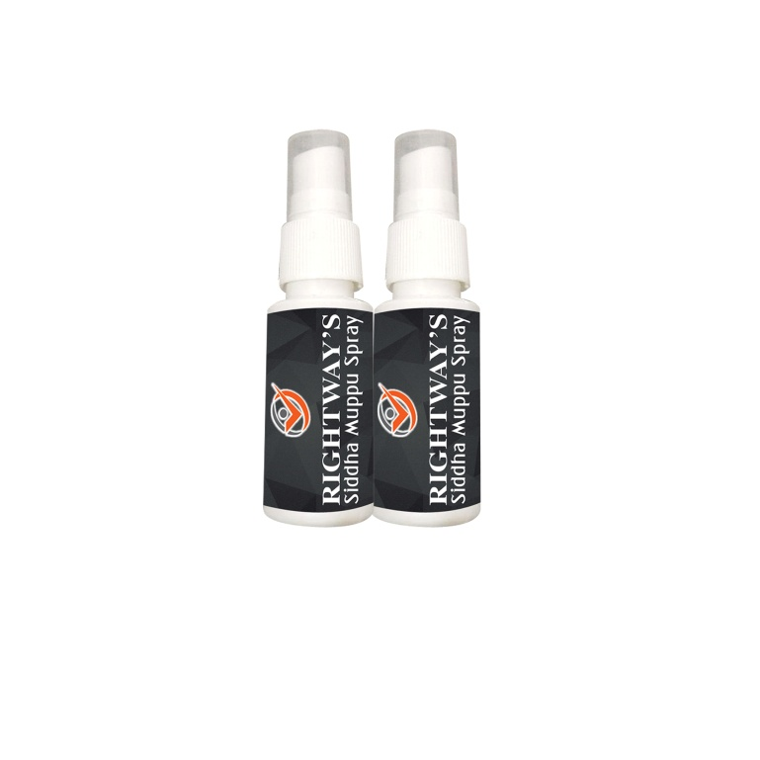
BASIC KIT
RIGHTWAY’S SIDDHA MUPPU SPRAY - 2
MRP
REF
BV
5500
500
500

Slide 9
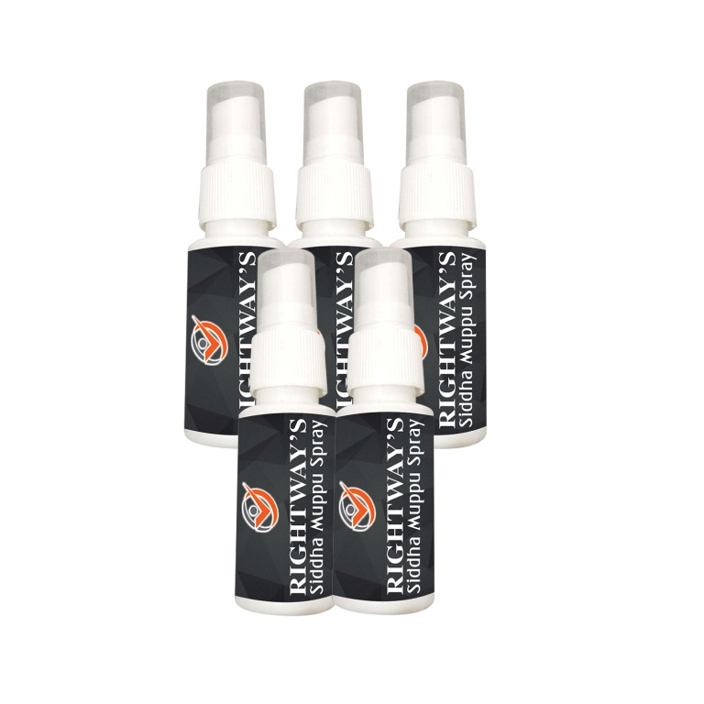
STANDARD KIT
RIGHTWAY’S SIDDHA MUPPU SPRAY - 5
MRP
REF
BV
13000
1000
1200

Slide 10
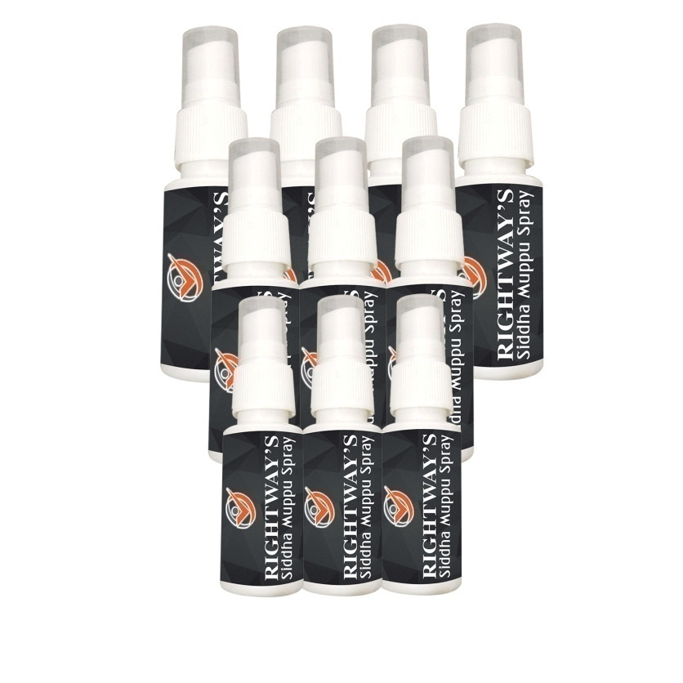
MEGA KIT
RIGHTWAY’S SIDDHA MUPPU SPRAY - 10
MRP
REF
BV
25500
2000
2350

Slide 11
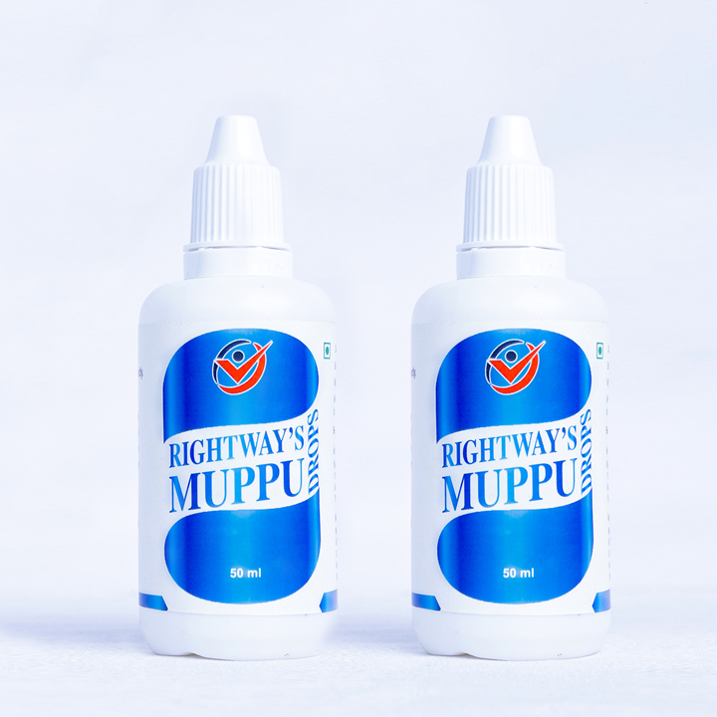
BASIC DROPS KIT
RIGHTWAY’S MUPPU DROPS - 2
MRP
REF
BV
5500
500
500

Slide 12
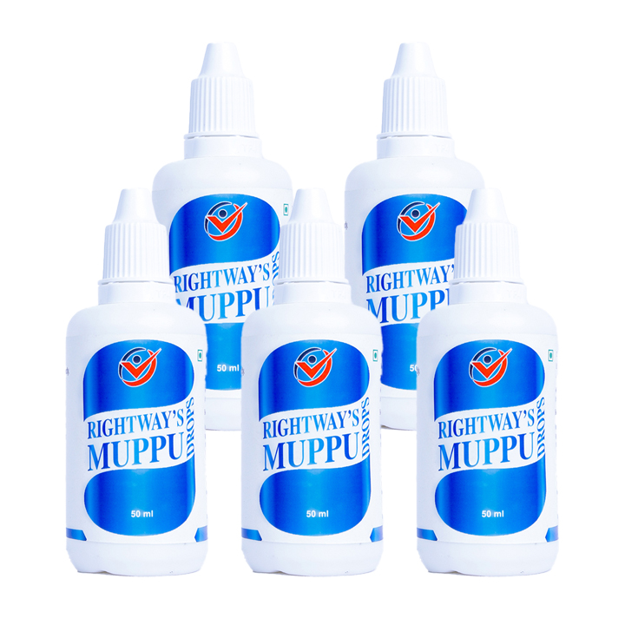
STANDARD DROPS KIT
RIGHTWAY’S MUPPU DROPS - 5
MRP
REF
BV
13000
1000
1200

Slide 13
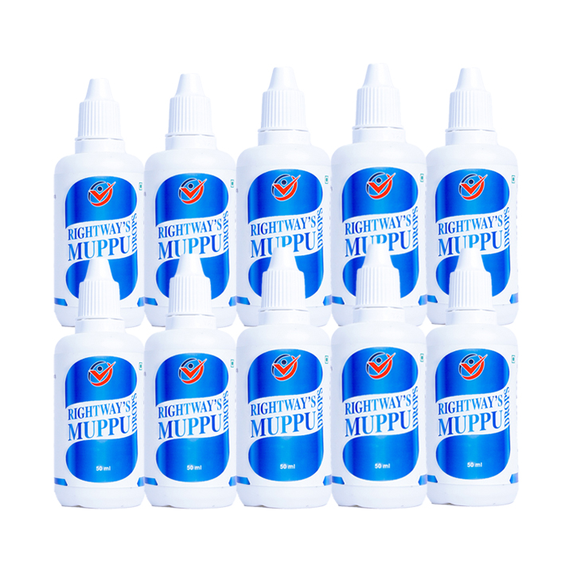
MEGA DROPS KIT
RIGHTWAY’S MUPPU DROPS - 10
MRP
REF
BV
25500
2000
2350

Slide 14
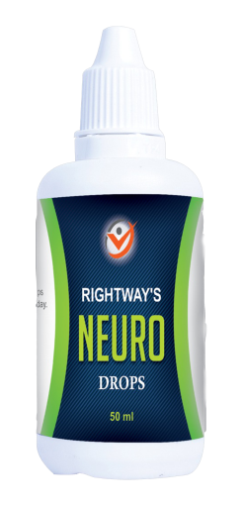
BASIC NEURO KIT
RIGHTWAY’S NEURO DROPS - 2
MRP
REF
BV
5200
500
470

Slide 15
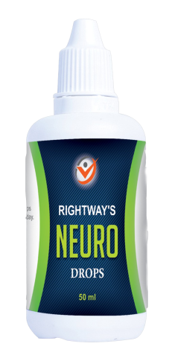
STANDARD NEURO KIT
RIGHTWAY’S NEURO DROPS - 5
MRP
REF
BV
12500
1000
1150

Slide 16
MEGA NEURO DROPS KIT
RIGHTWAY’S NEURO DROPS - 10
MRP
REF
BV
24000
2000
2200

Slide 17
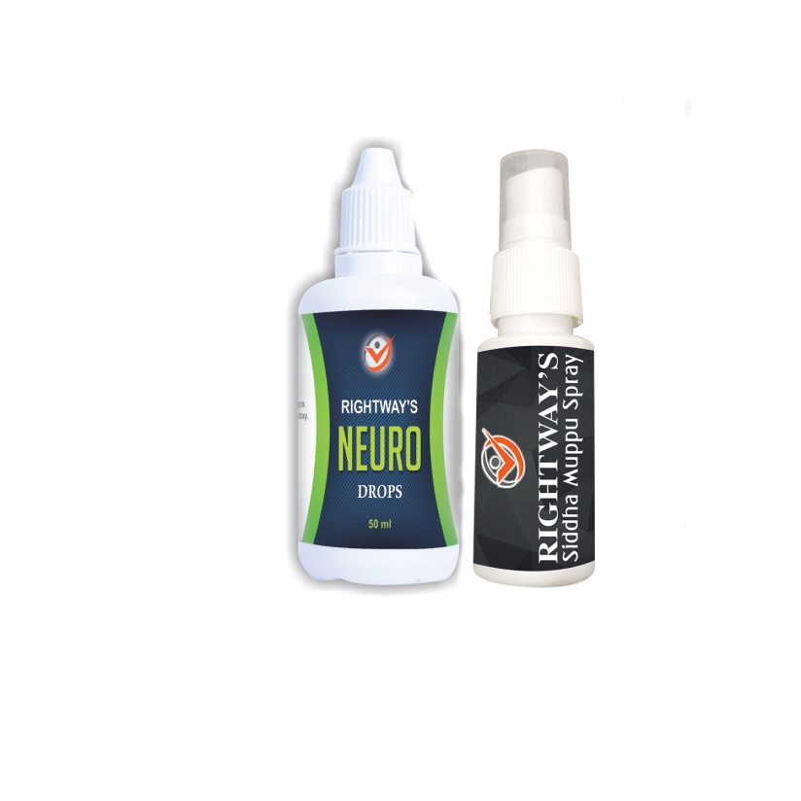
STARTER KIT
RIGHTWAY’S SIDDHA MUPPU SPRAY - 1
RIGHTWAY’S NEURO DROPS -1
MRP
REF
BV
5500
500
500

Slide 18
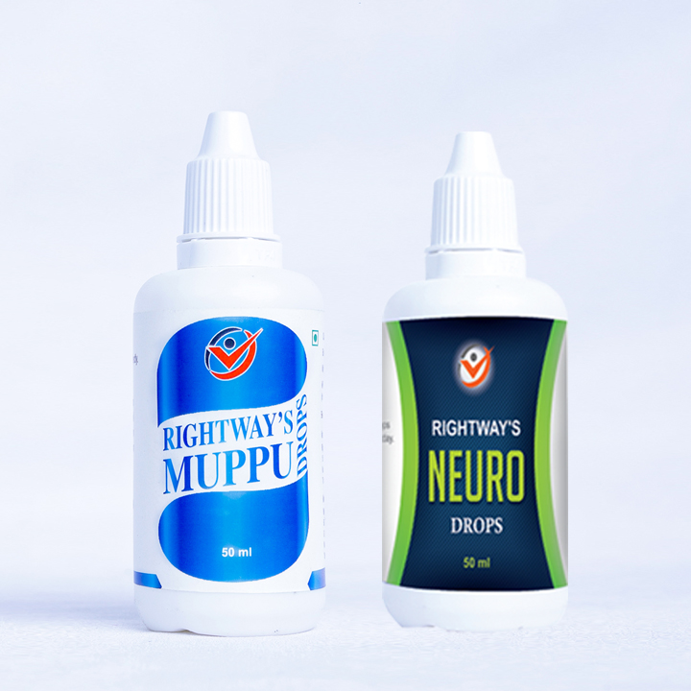
ADVANCE KIT
RIGHTWAY’S MUPPU DROPS -1
RIGHTWAY’S NEURO DROPS -1
MRP
REF
BV
5500
500
500

Slide 19
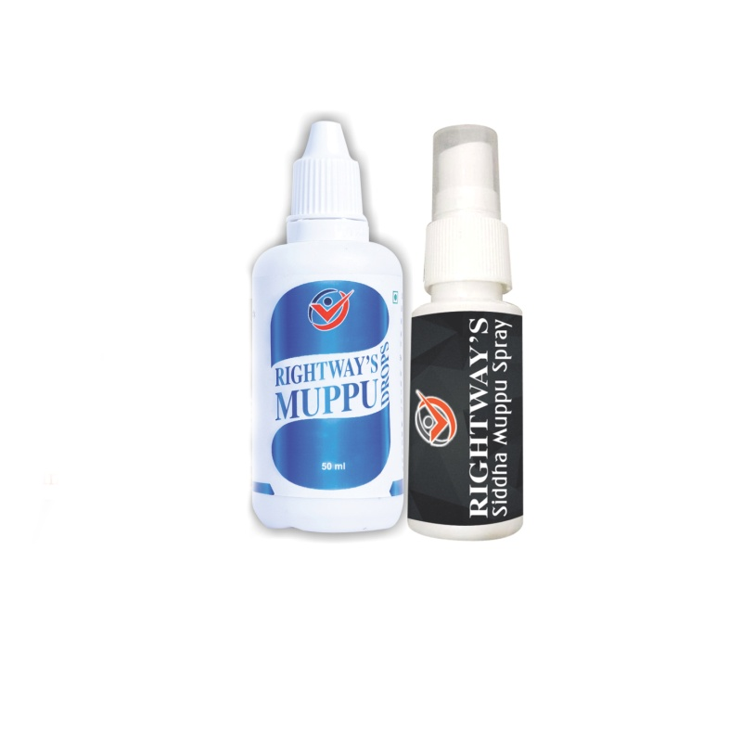
ULTRA KIT
RIGHTWAY’S SIDDHA MUPPU SPRAY - 1
RIGHTWAY’S MUPPU DROPS - 1
MRP
REF
BV
5500
500
550

Slide 20
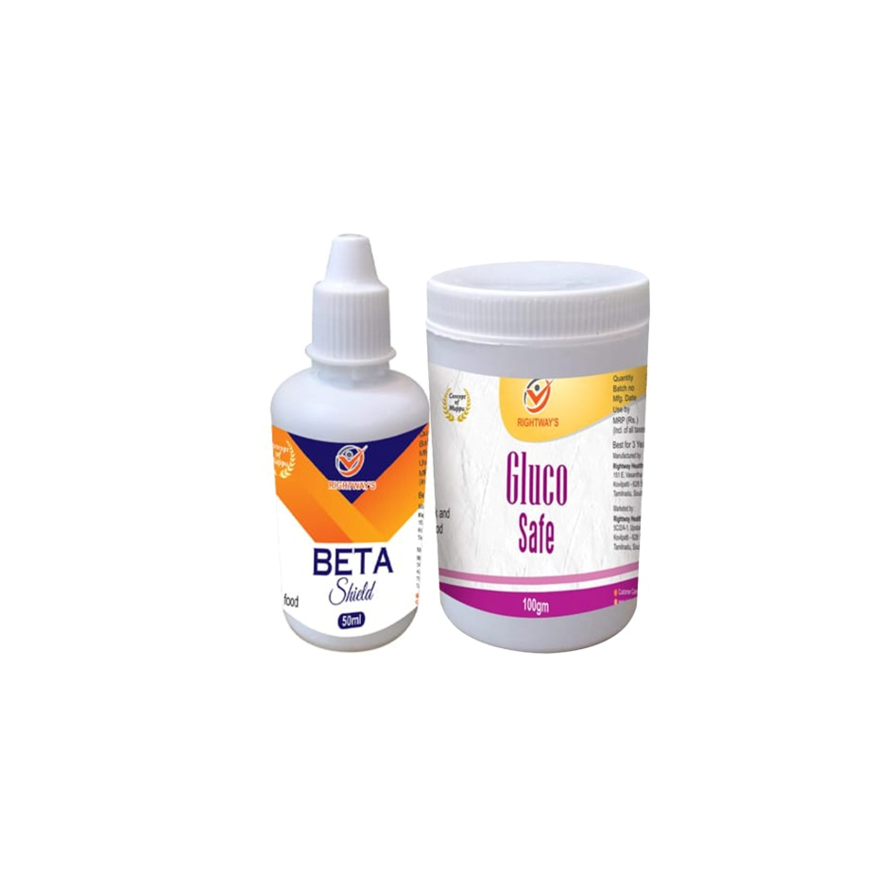
BOOSTER KIT
RIGHTWAY’S BETA SHIELD - 1
RIGHTWAY’S GLUCO SAFE - 1
MRP 5500
REF 500
BV 500

Slide 21
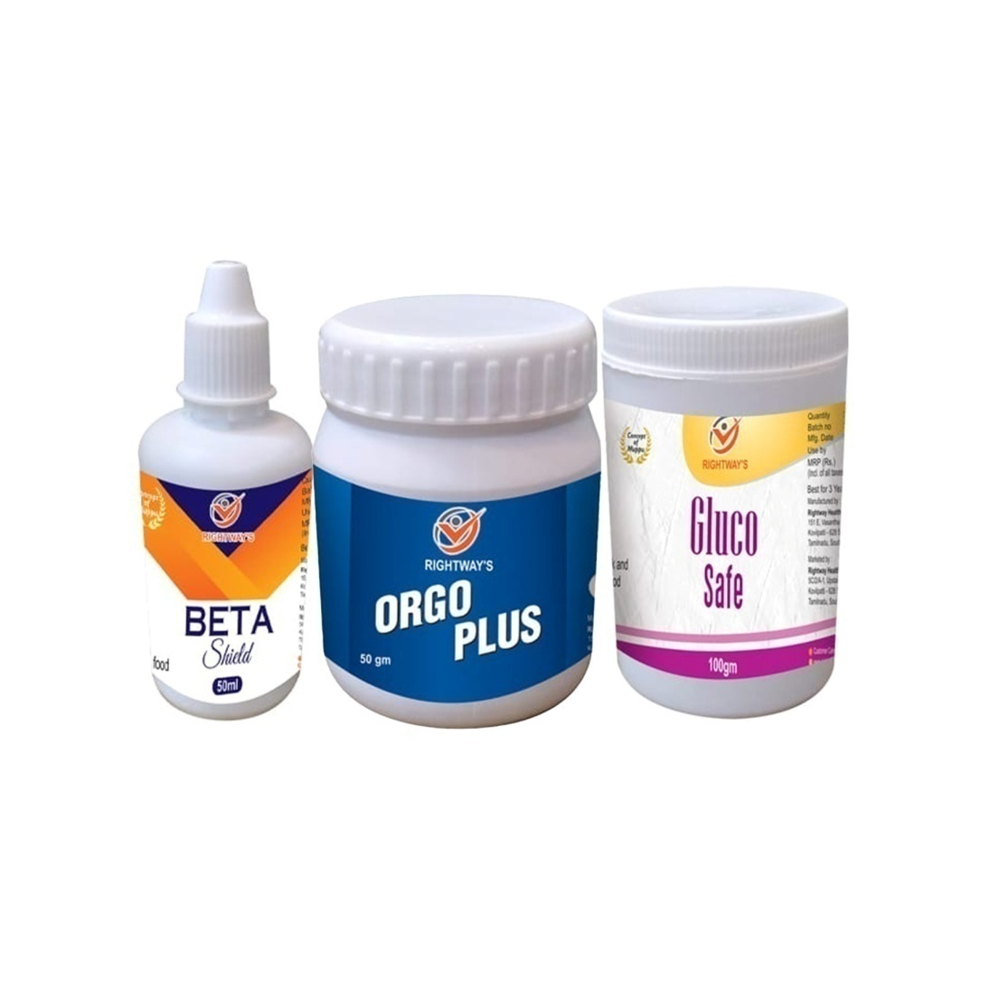
ACTIVE KIT
RIGHTWAY’S BETA SHIELD - 1
RIGHTWAY’S GLUCO SAFE - 1
RIGHTWAY’S ORGO PLUS - 1
MRP 8000
REF 500
BV 750

Slide 22
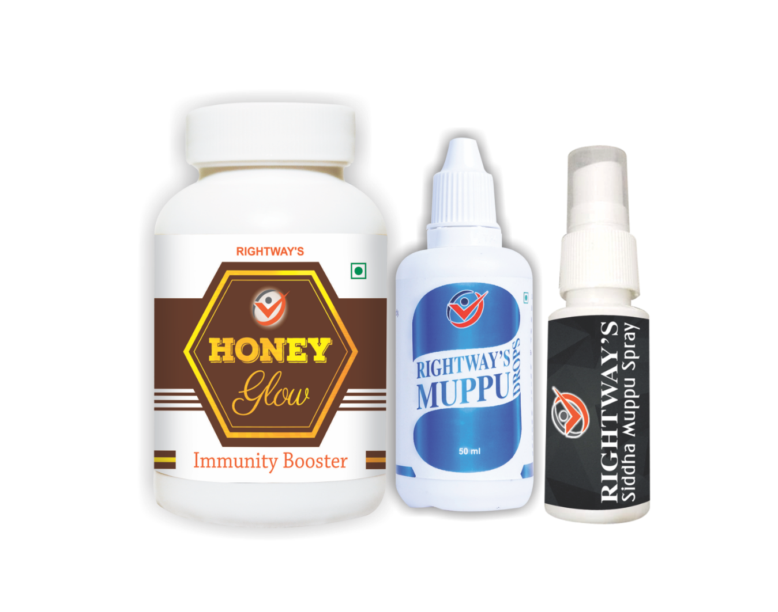
DIVINE KIT
RIGHTWAY’S SIDDHA MUPPU SPRAY - 1
RIGHTWAY’S MUPPU DROPS - 1
HONEY GLOW (220gm) - 1
MRP
REF
BV
27000
2000
2500

Slide 23
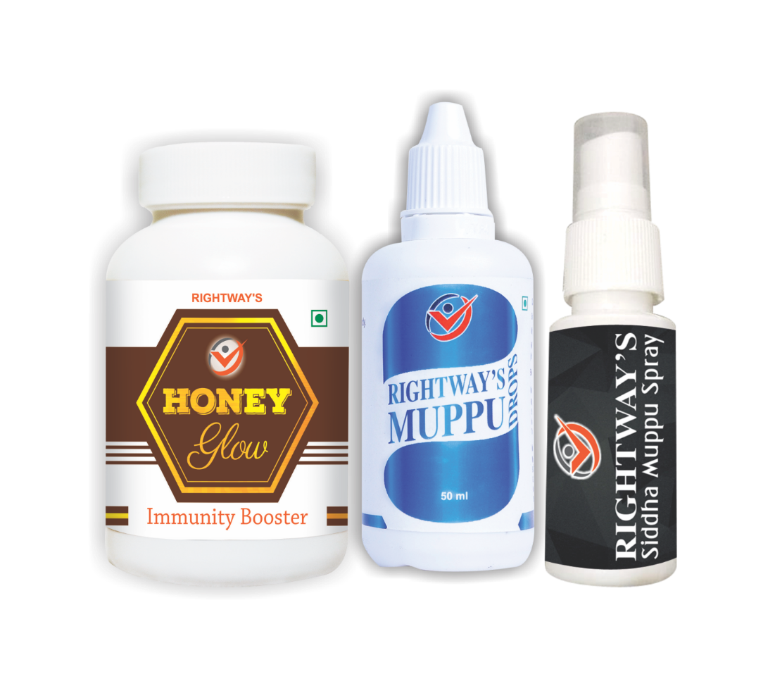
MINI DIVINE KIT
RIGHTWAY’S SIDDHA MUPPU SPRAY - 1
RIGHTWAY’S MUPPU DROPS - 1
HONEY GLOW (120gm) - 1
MRP
REF
BV
17,500
1,500
1,600

Slide 24
ELITE KIT
HONEY GLOW(220 GM) - 1
RIGHTWAY’S MUPPU DROPS - 1
RIGHTWAY’S SIDDHA MUPPU SPRAY - 1
RIGHTWAY’S NEURO DROPS - 1
MRP
REF
BV
30,000
2,500
2,750

Slide 25
CARE KIT
HONEY GLOW(220 GM) - 1
RIGHTWAY’S MUPPU DROPS - 1
RIGHTWAY’S SIDDHA MUPPU SPRAY - 1
RIGHTWAY’S ORGO PLUS - 1
MRP
REF
BV
30000
2500
2750

Slide 26
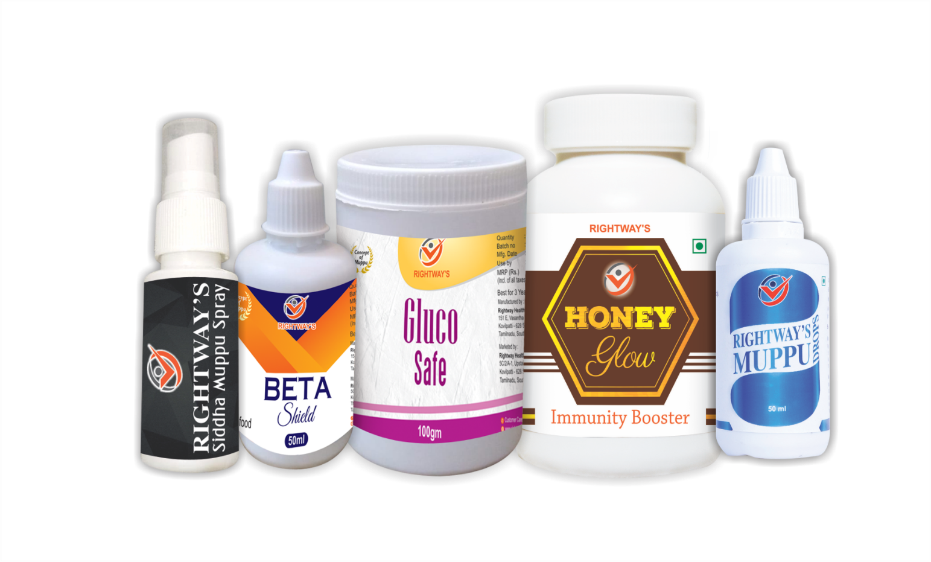
PREMIUM KIT
HONEY GLOW(220 GM) - 1
RIGHTWAY’S MUPPU DROPS - 1
RIGHTWAY’S SIDDHA MUPPU SPRAY - 1
RIGHTWAY’S GLUCO SAFE -1
RIGHTWAY’S BETA SHIELD - 1
MRP
REF
BV
32500
2500
3000

Slide 27
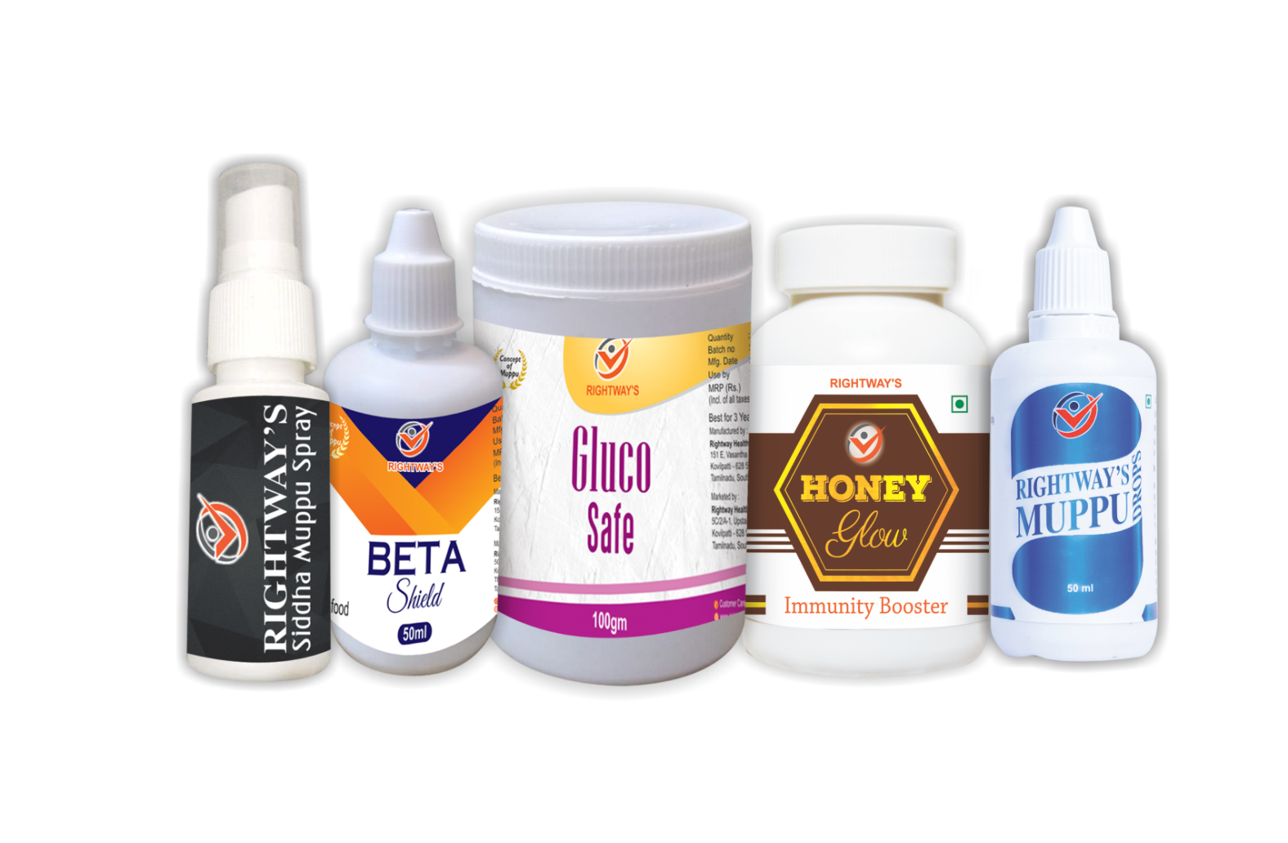
MINI PREMIUM KIT
HONEY GLOW(120 GM) - 1
RIGHTWAY’S MUPPU DROPS - 1
RIGHTWAY’S SIDDHA MUPPU SPRAY - 1
RIGHTWAY’S GLUCO SAFE -1
RIGHTWAY’S BETA SHIELD - 1
MRP
REF
BV
23,000
2,000
2,100

Slide 28
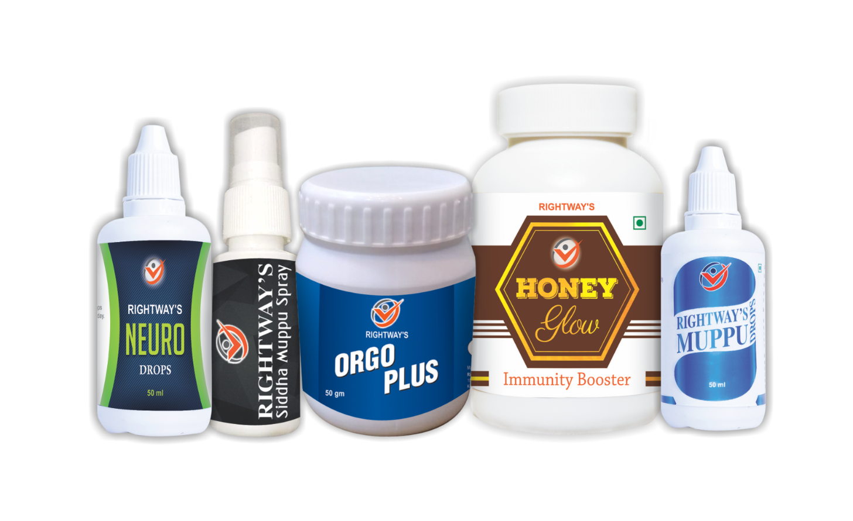
ROYAL KIT
HONEY GLOW(220 GM) - 1
RIGHTWAY’S MUPPU DROPS - 1
RIGHTWAY’S SIDDHA MUPPU SPRAY - 1
RIGHTWAY’S NEURO DROPS - 1
RIGHTWAY’S ORGO PLUS -1
MRP
REF
BV
32500
2500
3000

Slide 29
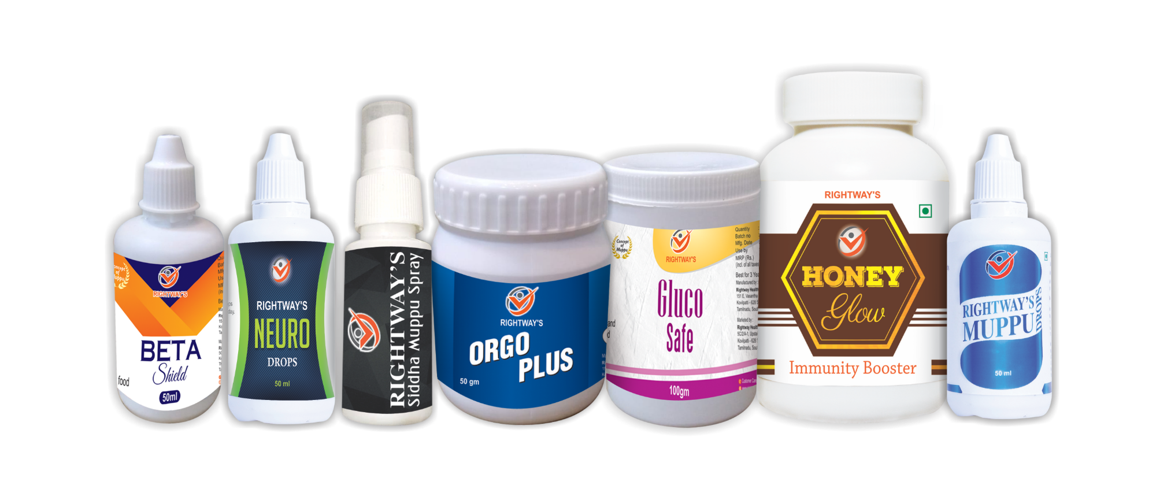
UNIVERSAL KIT
HONEY GLOW(220 GM) - 1
RIGHTWAY’S MUPPU DROPS - 1
RIGHTWAY’S SIDDHA MUPPU SPRAY - 1
RIGHTWAY’S NEURO DROPS - 1
RIGHTWAY’S GLUCO SAFE -1
RIGHTWAY’S BETA SHIELD -1
RIGHTWAY’S ORGO PLUS -1
MRP
REF
BV
37500
2500
3500

Slide 30
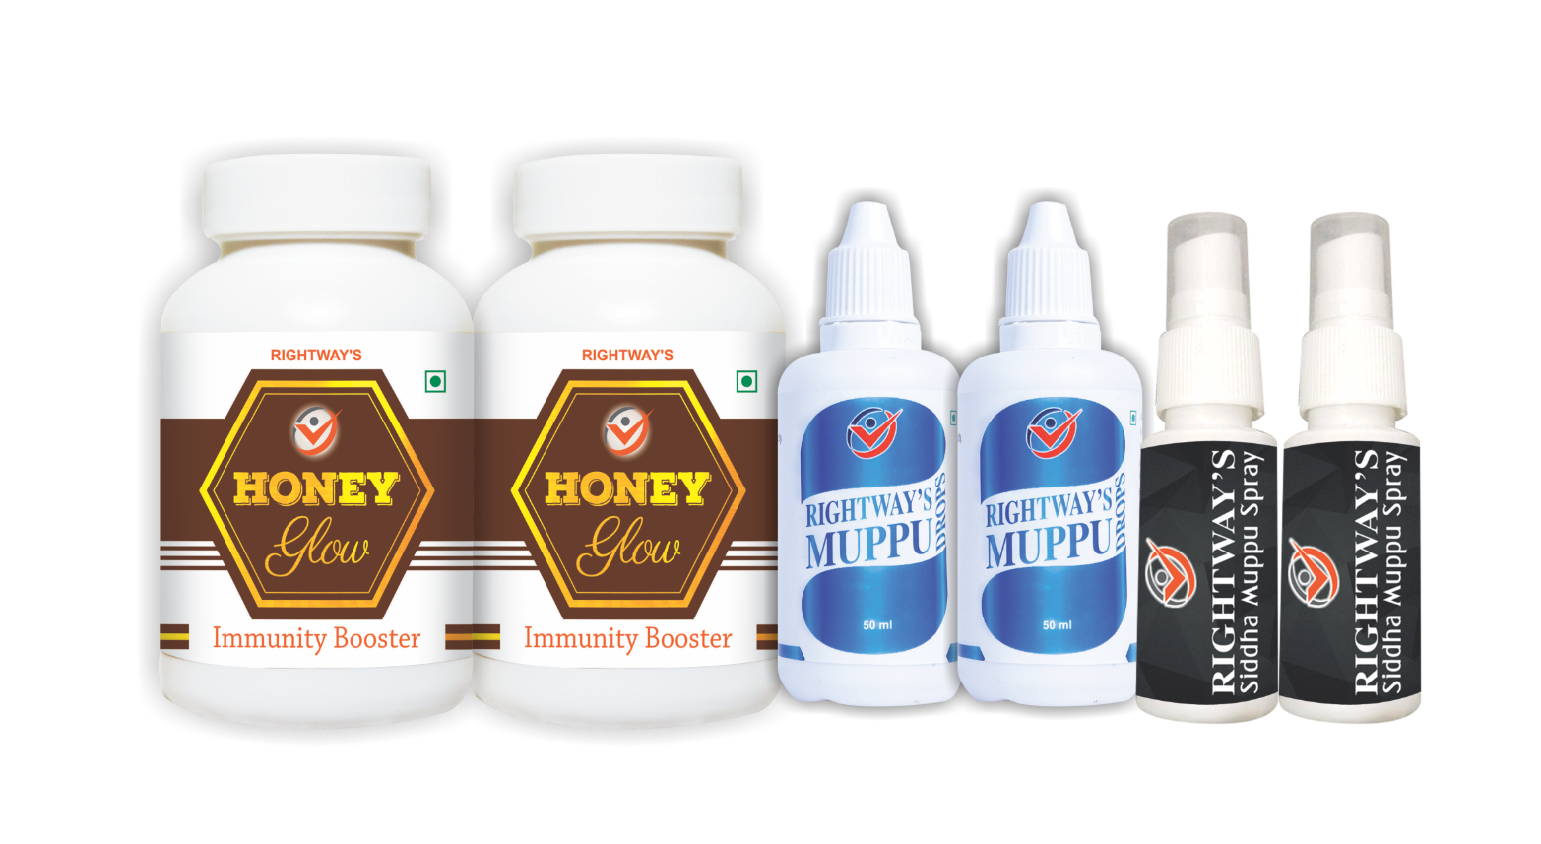
MEGA DIVINE KIT
HONEY GLOW(220 GM) - 2
RIGHTWAY’S MUPPU DROPS - 2
RIGHTWAY’S SIDDHA MUPPU SPRAY - 2
MRP 50,000
REF 5000
BV 4500

Slide 31
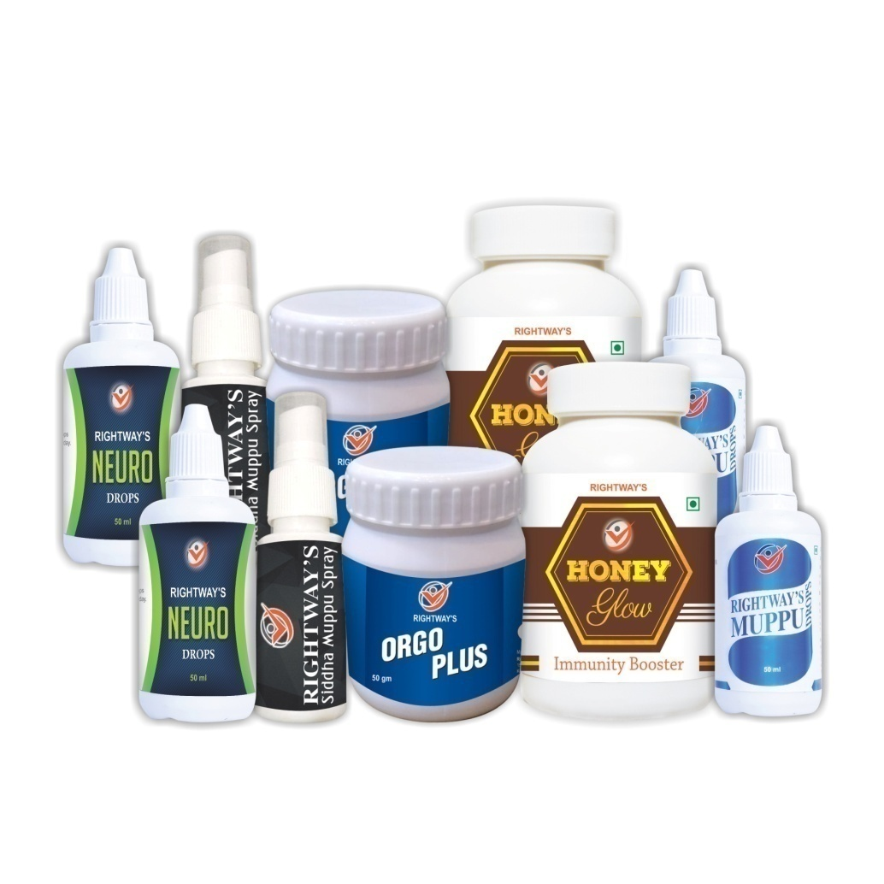
MEGA ROYAL KIT
HONEY GLOW(220 GM) - 2
RIGHTWAY’S MUPPU DROPS - 2
RIGHTWAY’S SIDDHA MUPPU SPRAY - 2
RIGHTWAY’S NEURO DROPS - 2
RIGHTWAY’S ORGO PLUS - 2
MRP
REF
BV
63000
5000
5800

Slide 32
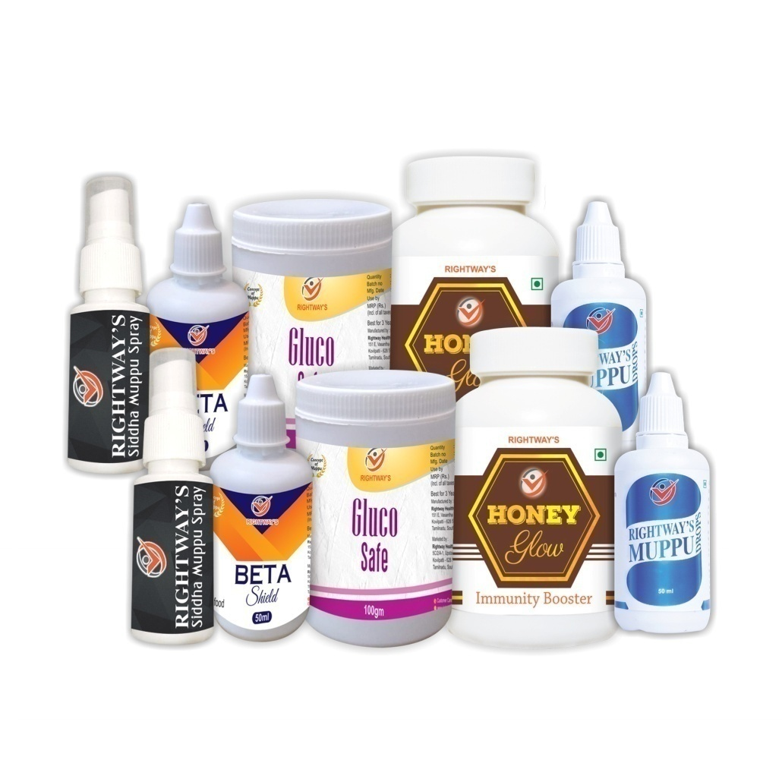
MEGA PREMIUM KIT
HONEY GLOW(220 GM) - 2
RIGHTWAY’S MUPPU DROPS - 2
RIGHTWAY’S SIDDHA MUPPU SPRAY - 2
RIGHTWAY’S GLUCO SAFE - 2
RIGHTWAY’S BETA SHIELD - 2
MRP
REF
BV
63000
5000
5800

Slide 33
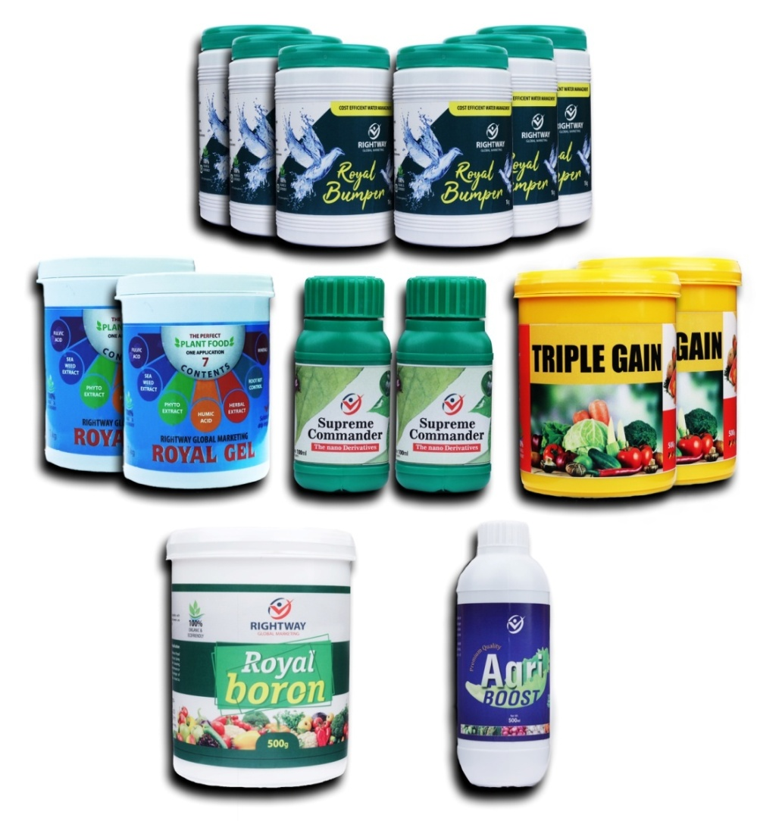
AGRI COMBO KIT
ROYAL BUMBER 1KG - 6
ROYALGEL 1 KG - 2
ROYAL BORON 500GM - 1
TRIPLE GAIN 500 GM - 2
SUPREME COMMANDER 100ML - 2
AGRI BOOST 250 ML - 1
MRP : 13500
BV : 820

Slide 34
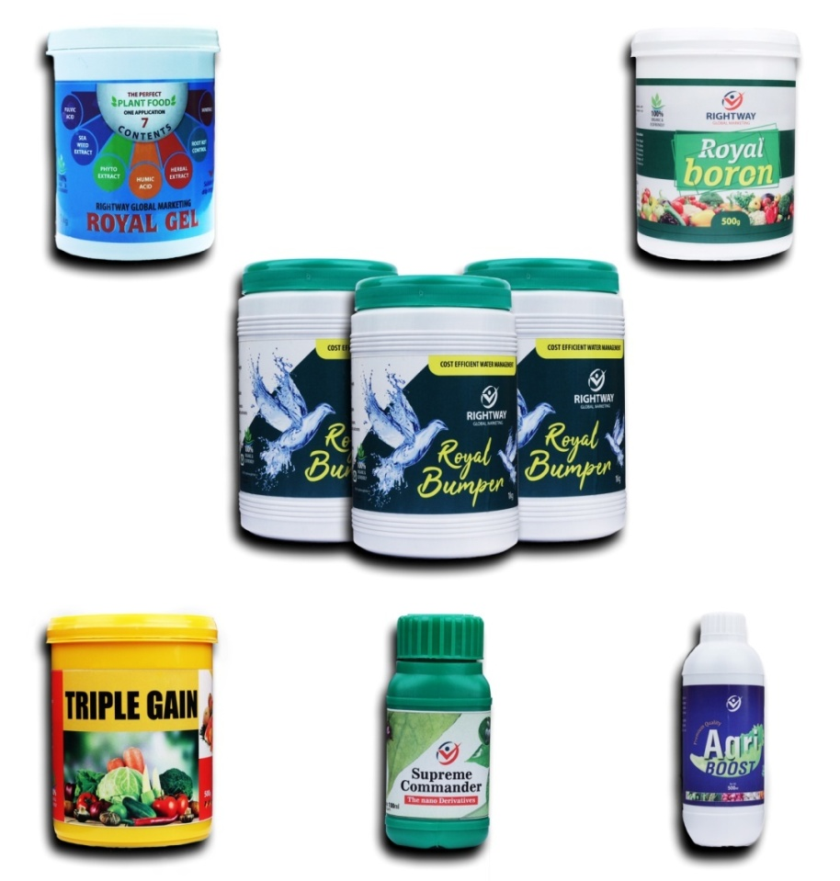
AGRI MINI KIT
ROYAL BUMBER 1KG - 3
ROYALGEL 1 KG - 1
ROYAL BORON 500GM - 1
TRIPLE GAIN 500 GM - 1
SUPREME COMMANDER 100ML - 1
AGRI BOOST 250 ML - 1
MRP : 7000
BV : 410

Slide 35
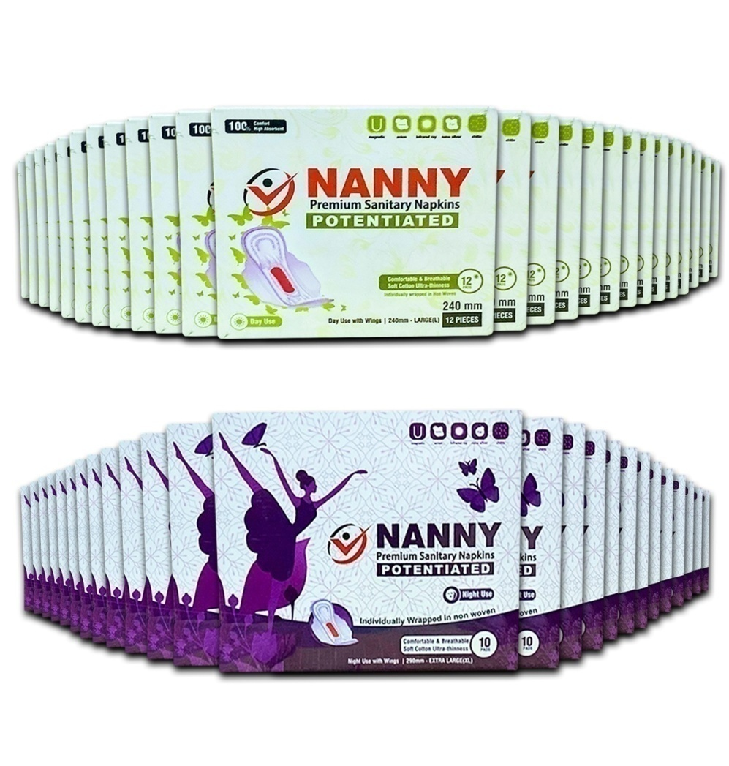
NANNY KIT
NANNY NAPKINS - 50 PKT
MRP : 8000
BV : 200

Slide 36
REGISTRATION & ACTIVATION
≡ Id absolutely free.
≡ Purchase any of our products for minimum 200 BV
in MRP to activate your Id.
≡ Once activated you can go for repurchase in
discount price forever.
≡ Promote our products for income
≡ Maximum 3 Ids for one pan

Slide 37
TEAM MATCHING BONUS
U
A
B
1BV : 1BV = Rs.1
CEILING Rs. 1,25,000/- Per Week

Slide 38
TEAM MATCHING BONUS
Both MRP and DP BVs of your team are calculated for Weekly Payout.
No Id Renewal
No Admin Charges
Non Matched BV's will be carry forwarded
Weekly Cut Off : Every Friday 7:00 pm

Slide 39
REFERRAL INCOME
U
A
B
C
D
E
F
Unlimited Direct sponsors
Unlimited Income

Slide 40
SPONSOR ROYALTY INCOME
I. Level - 2%
II. Level - 2%
III. Level- 2%
IV. Level -2%
V. Level - 2%
Total 10% of Team income
Unlimited income

Slide 41
RETAIL PROFIT
Purchase for Rs 1,00,000 to 4,99,999 - 25%
Purchase for Rs 5 Lakhs above - 30%
Note : Purchase should be done only in Activated ids.

Slide 42
AWARDS AND REWARDS

Slide 43
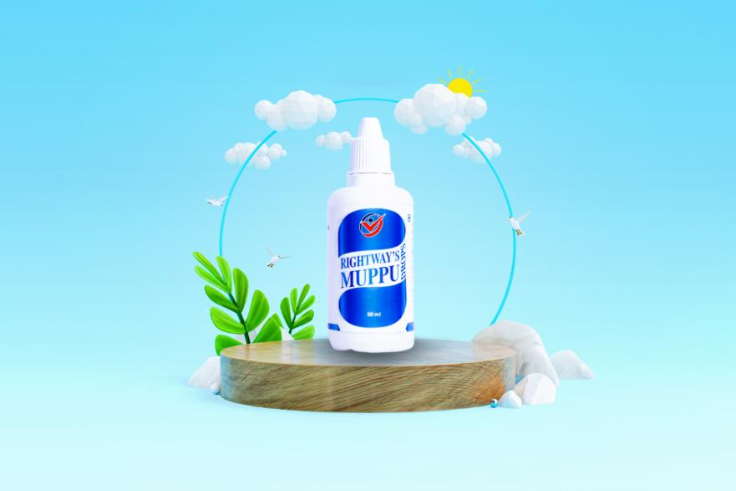
REWARDS
MUPPU DROPS
BRONZE
ELIGIBILITY
10,000 BV
10,000 BV

Slide 44
REWARDS
DIVINE KIT
SILVER
ELIGIBILITY
5 BRONZE
5 BRONZE

Slide 45
REWARDS
2 LAKHS GOLD
GOLD
ELIGIBILITY
10 SILVER
10 SILVER

Slide 46
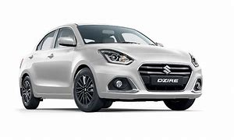
REWARDS
SWIFT DESIRE
PLATINUM
ELIGIBILITY
10 GOLD
10 GOLD

Slide 47
DIAMOND
ELIGIBILITY
REWARDS
50 LAKHS HOUSE
10 PLATINUM
10 PLATINUM

Slide 48
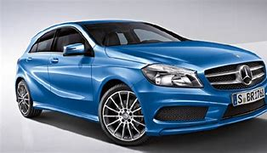
CROWN DIAMOND
ELIGIBILITY
REWARDS
MERCEDES BENZ CAR
10 DIAMOND
10 DIAMOND

Slide 49
AWARDS & REWARDS
 | ELIGIBILITY | REWARDS
BRONZE | Rs. 10000 INCOME | MUPU DROUPS
SILVER | LEFT 5 BRONZE RIGHT 5 BRONZE | DIVINE KIT
GOLD | LEFT 10 SILVER RIGHT 10 SILVER | 2LAKHS GOLD
PLATINUM | LEFT 10 GOLD RIGHT 10 GOLD | SWIFT DESIRE CAR
DIAMOND | LEFT 10 PLATINUM RIGHT 10 PLATINUM | 50 LAKHS HOUSE
CROWN DIAMOND | LEFT 10 DIAMOND RIGHT 10 DIAMOND | MERCEDES BEN Z CAR

Slide 50
AWARDS & REWARDS
BRONZE AND ABOVE MUST REPURCHASE FOR RS. 1000/- ON OR
BEFORE 5TH OF EVERY MONTH
1 ID FOR ONE PAN IS ELIGIBLE FOR AWARDS AND REWARDS

Slide 51
HAVE A GREAT DAY

